Slide 1



SYSTEMS DEVELOPMENT
Pursuit of Prestige
Presenters
Gabe Harmon
Emerson Brown
Chance Smits

Slide 2
Introduction
Presented by Emerson Brown

Slide 3

OVERVIEW
Mock luxury clothing site for a fake company titled “Pursuit of Prestige”
Features an elaborate front-end design scheme and some back-end functionality
Login system
Contact form

Slide 4
MOTIVATION
Providing luxury apparel and accessories from multiple name brands
Providing a comfortable user experience
Creating an online presence for the “business”

Slide 5
TARGET USERS
Individuals looking to purchase luxury clothing and accessories
Those with a large budget
Businesspeople

Slide 6
OUR TEAM
GABE HARMON
EMERSON BROWN
CHANCE SMITS
Front-end development experience
Project experience
Beginner back-end experience
Strong front end/debugger experience
Average backend experience
Intermediate backend experience
Project planning / documentation experience
Networking experience

Slide 7
Live demonstration

Slide 8
Under the hood
Presented by Gabe Harmon

Slide 9
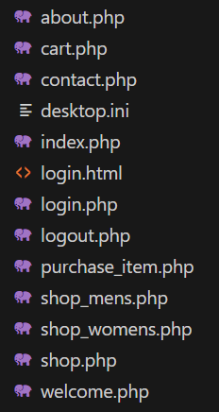

Slide 10
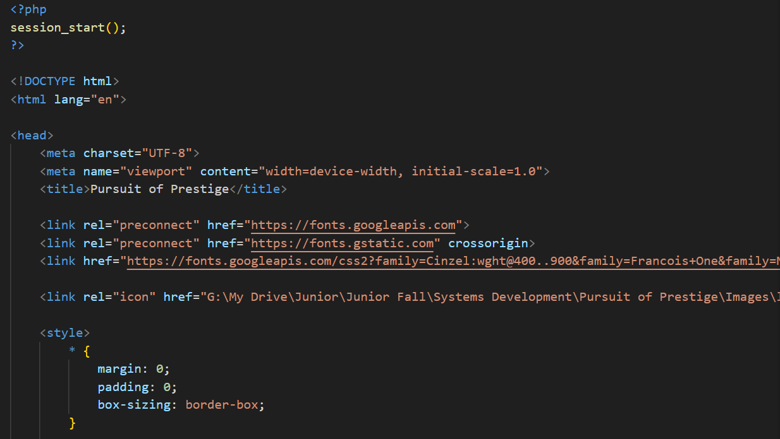
HEAD/INLINE CSS

Slide 11
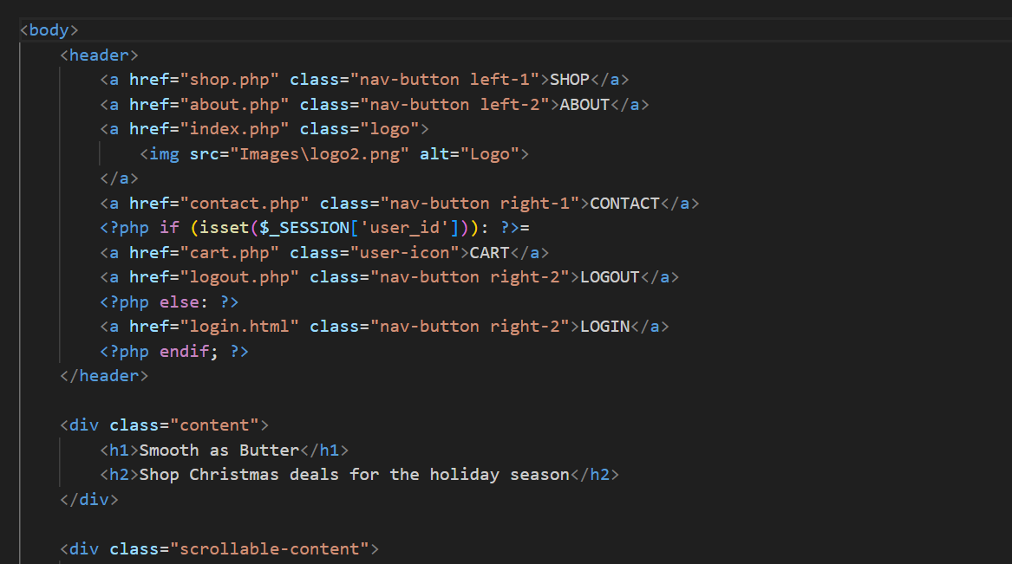
HEADER WITH PHP

Slide 12
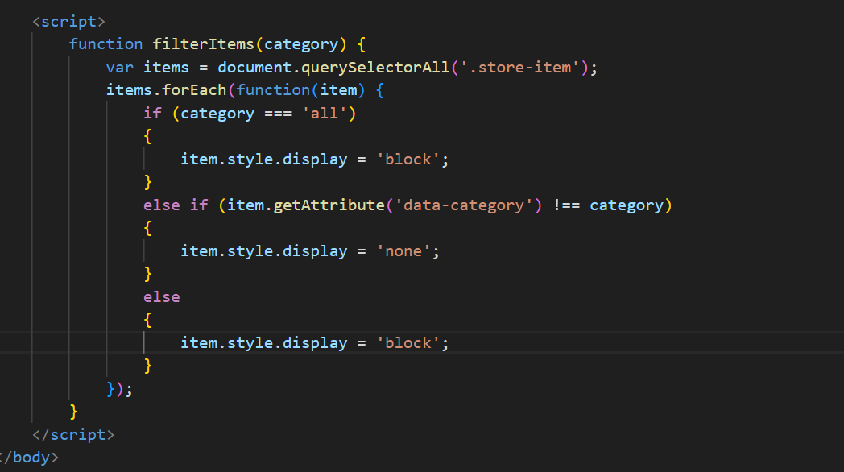
JAVASCRIPT

Slide 13
DEVELOPMENT TIME ALLOCATION
November 2nd
November 9th
November 16th
Simple HTML created
CSS added to pages
Improvements in site design style
November 23rd
November 30th
December 7th
Creation of purchasable items and shopping section
Basic back-end additions
Finalized back-end

Slide 14
Closing thoughts
Presented by Chance Smits

Slide 15
BUGS FIXED
Fixed issues with session tracking
Didn’t stay logged in when traversing webpages
Resolved by modifying PHP code
Fixed orientation issues on headers
Resolved by changing CSS settings
Fixed filtering system on shop pages
Resolved by improving JavaScript code

Slide 16
POTENTIAL FUTURE IMPROVEMENTS
Addition of a footer
More user login credentials
Ability to create an account
Minor visual improvements

Slide 17
Thank you!

